Slide 1
Interpreting Scatter Plots and Line of Best Fit EQ: How do I draw a line of best fit?

Slide 2
Quick recap
Positive correlation
Negative correlation
little or no correlation

Slide 3
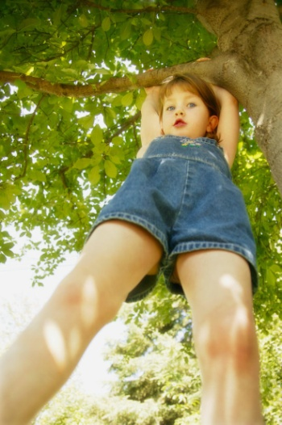
Positive Correlation
If you look at the age of a child and the child’s height, you will find that as the child gets older, the child gets taller. Because both are going up, it is positive correlation.
Age | 1 | 2 | 3 | 4 | 5 | 6 | 7 | 8
Height | 25 | 31 | 34 | 36 | 40 | 41 | 47 | 55

Slide 4

Negative Correlation
If you look at the age of your family’s car and its value, you will find as the car gets older, the car is worth less. This is negative correlation.
Age of car | 1 | 2 | 3 | 4 | 5
Value | $30,000 | $27,000 | $23,500 | $18,700 | $15,350

Slide 5
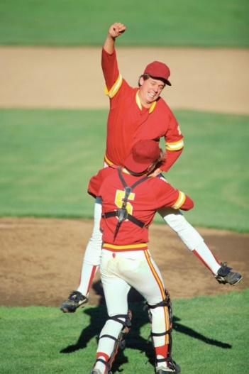
No Correlation
If you look at the size shoe a baseball player wears, and their batting average, you will find that the shoe size does not make the player better or worse, then are not related.

Slide 6
Example 1:
The scatter plots of data relate characteristics of children from
0 to 18 years old.
Match each scatter plot with the appropriate variables studied.
1. age and height
2. age and eye color
3. age and time needed to run a certain distance
no correlation between age and eye color
as your age increases your height also increases
2
1
as your age increases the time will decrease
3

Slide 7
If the data points are close to the line of best fit, it is said to have a ___________correlation.
strong
weak positive
strong positive
weak negative
strong negative

Slide 8

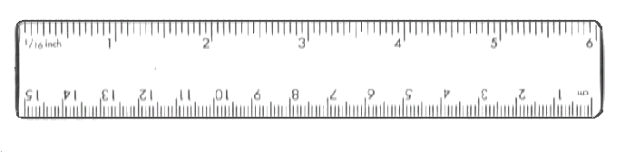
Drawing a Line of Best Fit
A line of best fit is a straight line that best represents the data on a scatter plot. It allows us to:
Understand the type and strength of the relationship between two sets of data
Predict missing Y values for given X values, or missing X values for given Y values
The sum of the vertical distances above the line should be roughly the same as those below.

Slide 9
Question 1
(1). The table below shows the shoe size and mass of 10 men.
(a) Plot a scatter graph for this data and draw a line of best fit.
Plotting the data points/Drawing a line of best fit/Answering questions.
Size
5
12
7
10
10
9
8
11
6
8
Mass
65
97
68
92
78
78
76
88
74
80
100
95
90
85
80
Mass (kg)
75
70
65
60
4
5
6
7
8
9
10
11
12
13
Shoe Size

Slide 10
(1). The table below shows the shoe size and mass of 10 men.
(a) Plot a scatter graph for this data and draw a line of best fit.
Size
5
12
7
10
10
9
8
11
6
8
Mass
65
97
68
92
78
78
76
88
74
80
100
95
90
85
80
Mass (kg)
75
70
65
60
4
5
6
7
8
9
10
11
12
13
Shoe Size

Slide 11
(1). The table below shows the shoe size and mass of 10 men.
(a) Plot a scatter graph for this data and draw a line of best fit.
Size
5
12
7
10
10
9
8
11
6
8
Mass
65
97
68
92
78
78
76
88
74
80
100
95
90
85
80
Mass (kg)
75
70
65
60
4
5
6
7
8
9
10
11
12
13
Shoe Size

Slide 12
(1). The table below shows the shoe size and mass of 10 men.
(a) Plot a scatter graph for this data and draw a line of best fit.
Size
5
12
7
10
10
9
8
11
6
8
Mass
65
97
68
92
78
78
76
88
74
80
100
95
90
85
80
Mass (kg)
75
70
65
60
4
5
6
7
8
9
10
11
12
13
Shoe Size

Slide 13
(1). The table below shows the shoe size and mass of 10 men.
(a) Plot a scatter graph for this data and draw a line of best fit.
Size
5
12
7
10
10
9
8
11
6
8
Mass
65
97
68
92
78
78
76
88
74
80
100
95
90
85
80
Mass (kg)
75
70
65
60
4
5
6
7
8
9
10
11
12
13
Shoe Size

Slide 14
(1). The table below shows the shoe size and mass of 10 men.
(a) Plot a scatter graph for this data and draw a line of best fit.
Size
5
12
7
10
10
9
8
11
6
8
Mass
65
97
68
92
78
78
76
88
74
80
100
95
90
85
80
Mass (kg)
75
70
65
60
4
5
6
7
8
9
10
11
12
13
Shoe Size

Slide 15
(1). The table below shows the shoe size and mass of 10 men.
(a) Plot a scatter graph for this data and draw a line of best fit.
Size
5
12
7
10
10
9
8
11
6
8
Mass
65
97
68
92
78
78
76
88
74
80
100
95
(b) Draw a line of best fit and comment on the correlation.
90
87 kg
Positive
85
80
(c) Use your line of best fit to estimate:
The mass of a man with shoe size 10½.
(ii) The shoe size of a man with a mass of 69 kg.
Mass (kg)
75
70
65
Size 6
60
4
5
6
7
8
9
10
11
12
13
Shoe Size

